Slide 1
Suggesting best candidate sites for opening Coffee shop
Bhaskar Tejaswi
July 8th, 2019

Slide 2
Introduction
Background :
Kolkata is the capital of West Bengal, India and it is the second largest city in India. The city is deeply rooted in its traditional values. However, modernisation has added a number of new elements in the city’s way of life. Coffee shops have become places where people hangout with their friends, spend some time working in the quiet environment and are willing to spend a fortune for the experience.

Slide 3
Introduction
Problem
Due to intense competition, selection of possible candidate sites is a major task. Opening any new business venture is a cost intensive exercise in which competition evaluation is important. Any new entrant would like to open their outlets in those pockets of the city where the existing market forces have not yet penetrated.

Slide 4
Source of Data
For obtaining the geolocation data, we will use google geocoder API.
For obtaining information about nearby coffee shops and restaurants to a particular location, we would use the Foursquare API.
We also use Onwater API to figure out if a geolocation point is on land or on water.

Slide 5
Methodology
a) We first find out the location of the centre of Kolkata city. This comes out to be as follows:
Coordinate of Kolkata, India: [22.572646, 88.36389500000001]
b) We then make a pool of neighbourhood sites that will be later probed for suitability for opening a coffee shop in radius of 6 km from the center of the city.
c) We find the address of all these sites in the candidate pool.
d) We define a function that returns the count of venues near a location belonging to a particular category.
e) We define candidate site selection criteria as follows:
Let X be a set of all possible candidate sites.
Then x E X would be a part of set of selected candidate sites Y only if
i) Number of coffee shops in 500 m radius of x is less than or equal to 2
ii) Number of restaurants in 500 m radius of x is at least 1
f) In case any location in Y is erroneous (e.g. Water body), we filter out those places.
g) We plot all the points contained in Y.

Slide 6
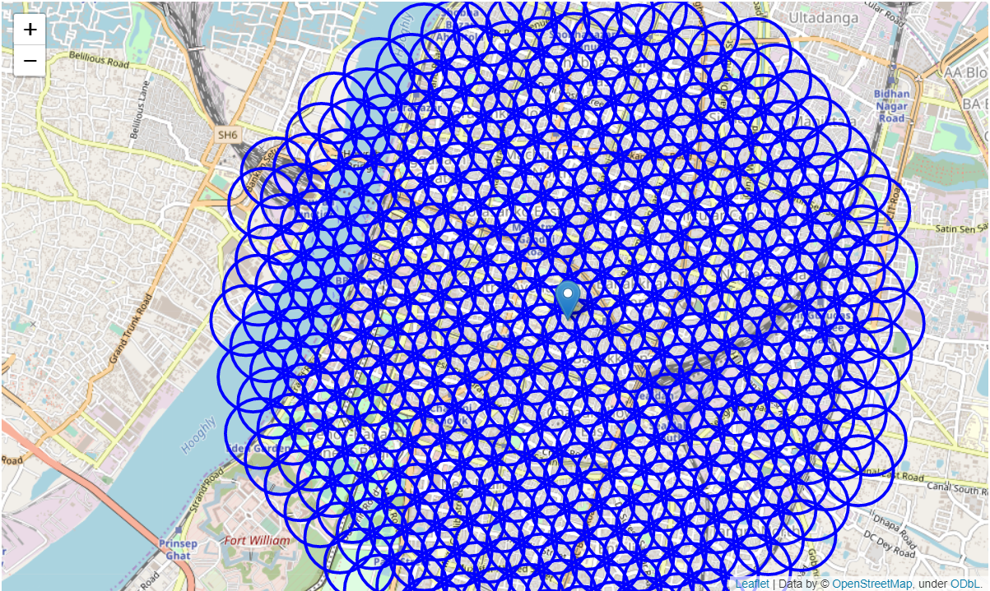
Results
Initially we begin by creating a pool of uniformly spread candidate sites within 6 km of the centre of the city.

Slide 7
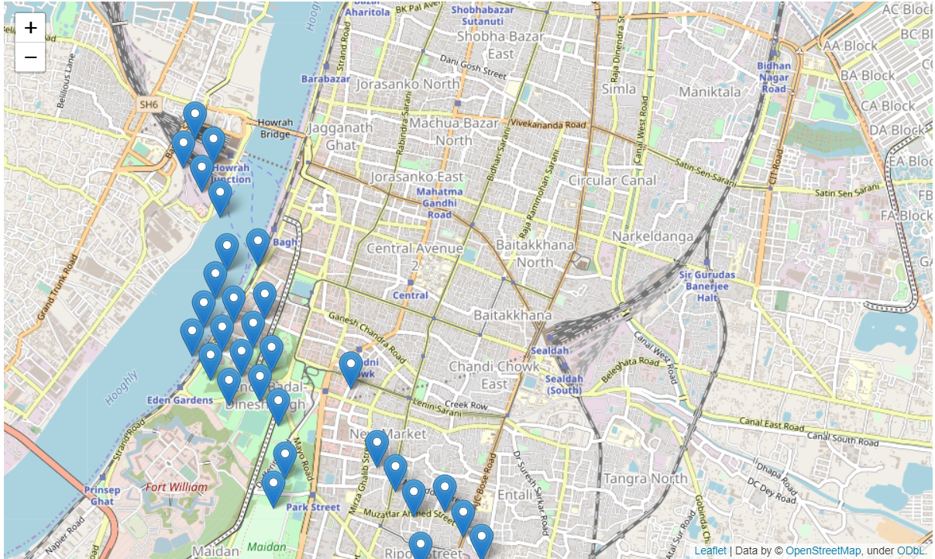
Results
We observe that there are 30 such places which satisfy the candidate site selection criteria.

Slide 8
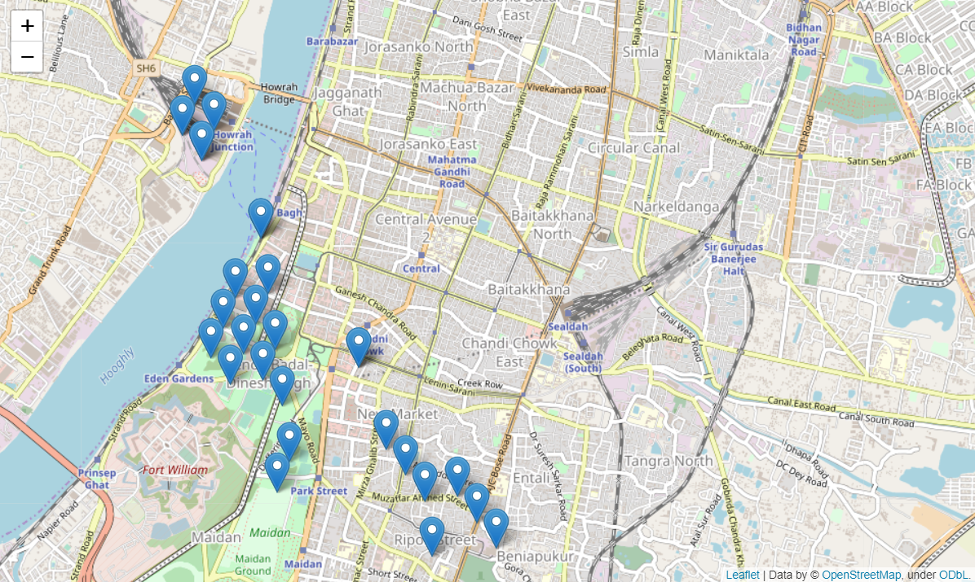
Results
We notice that some sites suggested are inside water body. In order to filter out these points, we use “Onwater” API.
The rectified list of candidate sites is finally plotted.

Slide 9
Discussion
We observe that a large number of candidate sites are located on the west side of the river, which makes sense as these points are closer to the centre of the city. Further, we can add parameters such as property cost of nearby areas, transport options in a locality etc. to further tune our findings.

Slide 10
Conclusion
Several local and contextual factors also come into play which should be considered, such as local market trends, demographic distribution of neighbourhoods etc. All of these should be discussed and agreed upon with the stakeholders to make a better judgement.

